Slide 1
Genetic Algorithms and The Travelling Salesperson Problem

Slide 2
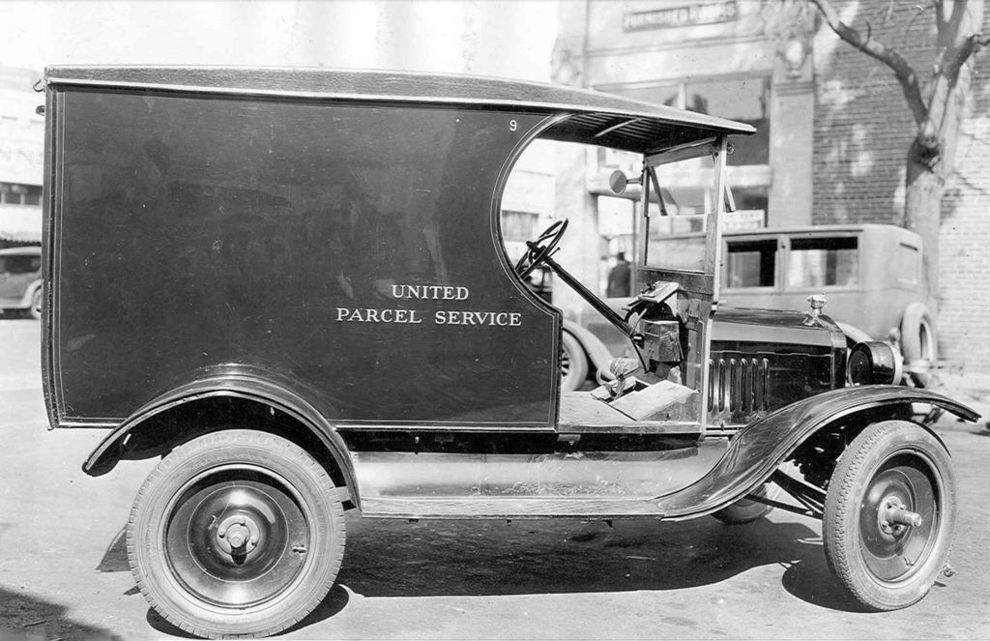
Let’s say that you wanted to start your very own courier service...
How would you do it?
How would you plan your day to day operations?
How many trucks would you use?
How would you start?

Slide 3
Let’s present some data on your competition. For this example, let just use data from U.P.S.
UPS is a behemoth!
They have 96000 Vehicles at their disposal.
They Deliver 17 Million packages to 9 million customers each day.
A reduction of just one mile each day per driver over the course of a year saves the company up to $50 million dollars.
UPS operates some 500 aircraft.
The UPS driver delivers air and ground packages out of the same delivery vehicle, no matter which level of service the customer has chosen.

Slide 4
UPS Statistics Continued.
More than 200 sensors in the vehicle inform UPS if the driver is wearing a seatbelt, how fast the vehicle is traveling, when the brakes are applied, if the bulkhead door is open, if the package car is going forward or backing up, the name of the street it’s traveling on, even how much time the vehicle has spent idling versus its time in motion.
Dead batteries discovered on Monday morning used to delay hundreds of drivers. Now they continually monitor battery conditions and take preemptive action, like changing out or charging batteries so vehicles stay on the road.
Big Data has contributed to a reduction of 85 million miles driven per year, 8.5 million gallons of fuel and 85,000 cubic tons of carbon emissions.
UPS Data sourced from:
https://pressroom.ups.com/pressroom/ContentDetailsViewer.page?ConceptType=Speeches&id=1426415450350-355

Slide 5
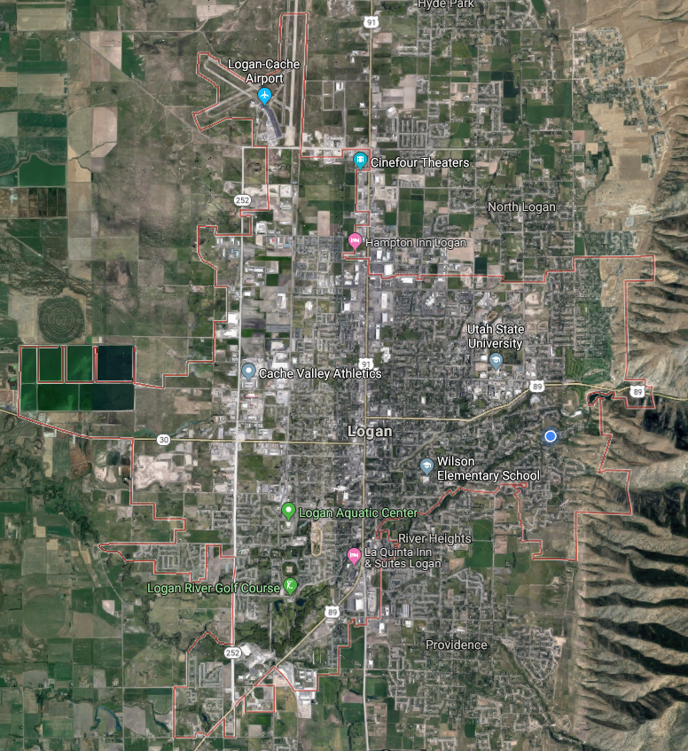
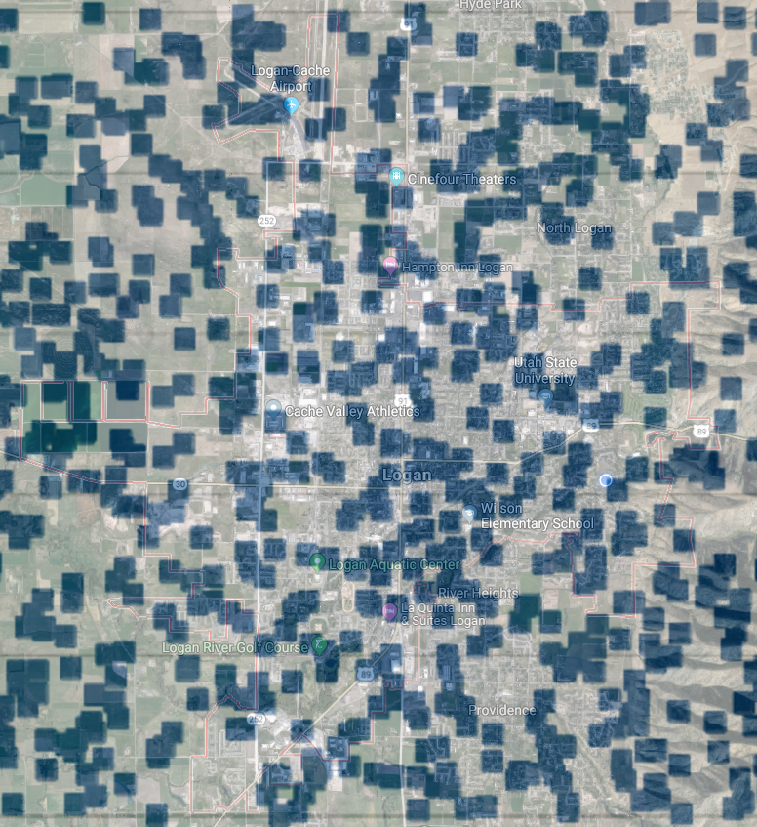
So now let’s focus on how can we extend the work we have already done.
With regards to the travelling salesman problem what can we do to obtain a “good” solution every time? Let’s say that you had to deliver 900 packages across logan in a single day.

Slide 6
Problem Setup
We have to deliver 900 packages to 900 unique locations.
We are going to stay within a 25 square mile area (LOGAN UTAH)
We are going to assume that Logan is a strongly connected graph where any physical address can be reached from any other address.
For this problem we are technically calculating distance “as the crow flies”, but we are going to assume that the distances don’t really matter because we can make a query to something (google, UPS maps, gps, etc...) The distances only matter when they are in correct proportion to the other measured distances.
We want to minimize the number of trucks that have to be driven, and we want to get all of this done in a 10 ish hour period.

Slide 7
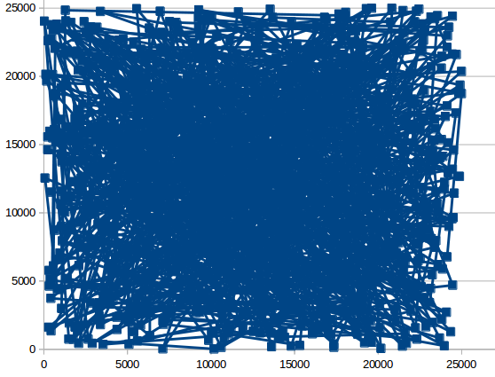
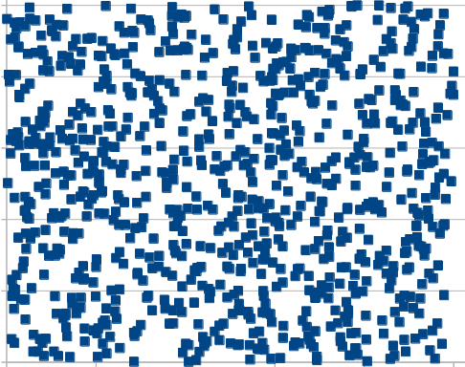
Approach
Now that we are familiar with the problem where do we start?
Can we do anything meaningful by just “eyeballing” the problem?
We may get something better than a random solution.
Currently the solution on the right would require about 2222 miles to complete.
What about using Genetic Algs. ?

Slide 8
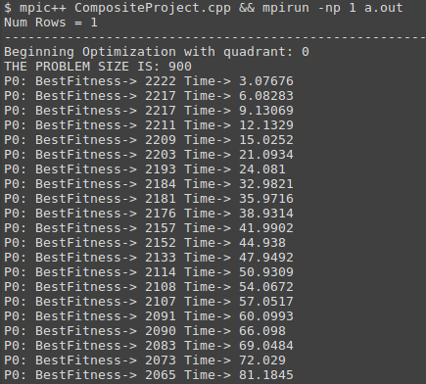
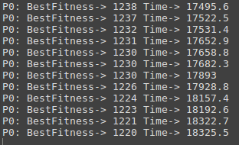
Travelling Salesman combined with Genetic Algorithms
This will not do!
We need a better approach that can find an answer with reasonable speed.
To accomplish this we need to ask why is this taking so long? And Can we go any faster?
What do you all think?
Genetic Algorithms are a great idea!
And we wait… and wait .. and wait…
So far we have shaved 1000 miles in about 4 hours. This is not looking good.
What if a package was cancelled?
What if a road was blocked?
We don’t have time for any sort of recalculation with this approach.

Slide 9
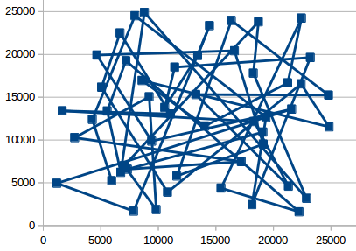
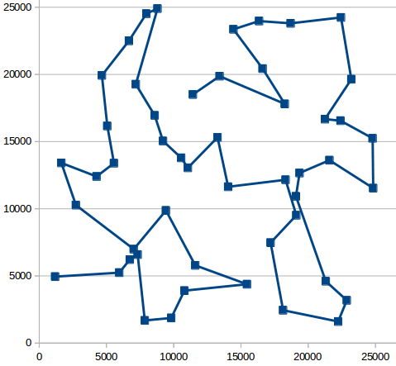
Improvements
Consider this, if you have say 50, 100, or 150 points on some map, then travelling salesman is really fast with that kind of solution. We can generate things like this:
This sort of operation literally takes seconds.
Is it the best?
Probably not,
But it is much better than randomly guessing, and it is probably faster than and more efficient that something we could do ourselves.
And that is the goal!

Slide 10
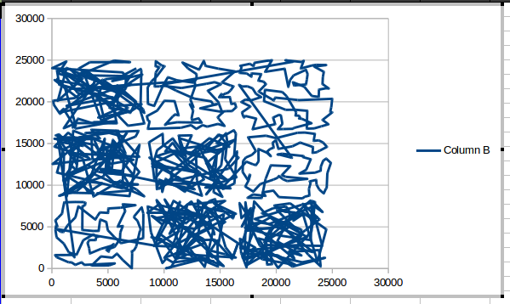
Improvements Continued...
How can we effectually divide and conquer our problem set?
What if we broke our problem up into sets of root quadrants? So that we divide our problem into 1 square, 4 squares, 9 squares, 16, 25, 36,... (draw on board) And make sure that we are snaking. We are effectively solving smaller problems multiple times rather than solving one big problem once.
Let’s start with 9 squares. Root 3.
Can you see the squares?
But what happened?

Slide 11
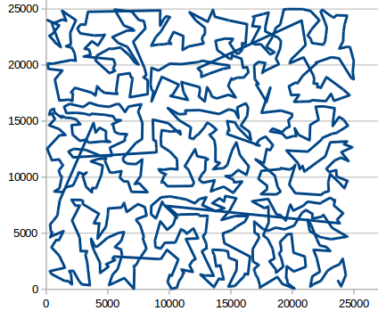
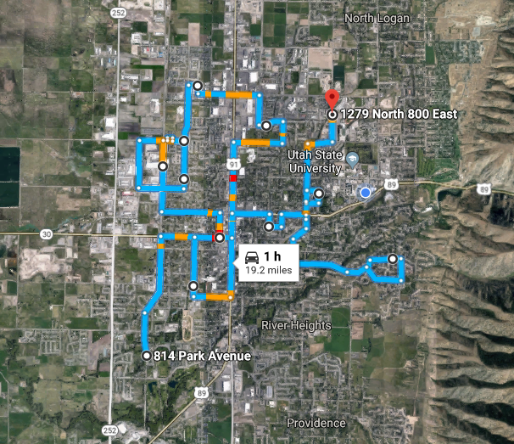
Solution
It wasn’t shown but, in my code I had a time condition on when to stop trying to find solutions on a particular set of points. I called it the noGainTimeLimit. This was just a timer to measure how long my program was trying to find a better solution without actually finding one. Once I increased this limit to about 6 minutes… That is 6 minutes of dead time a piece. This particular solution is about 113 miles. And everyone knows that you can only drive about 19 miles per hour in logan any way.

Slide 12
Closing Remarks
What was shown?
The combination of “small” discreet problems is an excellent application for parallel programming.
Significant gains can be made by solving a number of “small” problems, rather than trying to solve a single large problem. We started in a probable worst case of 2222 miles, and improved that to “not the best” but significantly better, 113 miles.
As was mentioned before the distance really isn’t what is important here. What is important is that we have a reliable consistent method that can produce meaningful results in a relatively short amount of time.

Slide 13
Future work
This was fun!
The biggest and perhaps most important chunk of future work to do is to find some sort of service that can find distances between points in a relatively fast amount of time.
Further work could be done in applying a time cost to these deliveries.
The idea is to obtain as good a measurement you can of everything you can and then start making optimizations.

